Slide 2
Unit II (6 lectures)
Natural resources and ecosystem : introduction to natural resources, renewable and non-renewable resources, land, water, forest and energy resources- their associated problems and remedial measures, role of individual in conservation of natural resources, ecosystem: structure and function of ecosystem, types of ecosystem, energy flow in an ecosystem: food chains and food webs, ecological pyramids, ecological succession.

Slide 3
Natural resources
are resources that are drawn from nature and used with few modifications.
This includes the sources of valued characteristics such as commercial and industrial use, aesthetic value, scientific interest, and cultural value.
On Earth, it includes sunlight, atmosphere, water, land, all minerals along with all vegetation, and wildlife.

Slide 4
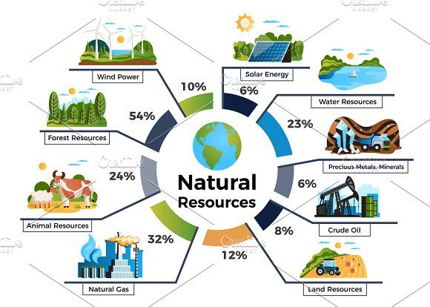

Slide 5
Classification
the source of origin
Biotic
Abiotic
flora and fauna, fisheries, livestock, Fossil fuels
non-living and inorganic material

Slide 6
Renewable and non-renewable resources
 | Characteristics | Renewable energy resources | Non-Renewable energy resources
1 | Defination | Natural resources that can be replenished in a human timescale. | Natural resources that cannot be replenished in a human timescale
2 | formation | Formed through natural processes, such as the Sun's energy and wind, that can be replenished quickly | Formed through slow geological processes, such as the fossilization of plants and animals, that cannot be duplicated in a human timescale
3 | Examples | Solar Energy, Wind Energy, Hydro Energy, Geothermal Energy, Bioenergy | Coal, Oil, Natural gas, Iron, Copper, Uranium
4 | Supply | Unlimited supply as long as the natural processes do not get disrupted | Limited Supply, Cannot be Replenished
5 | Environmental impacts | Generally low, as long as they are managed sustainably | Can be significant, including Air Pollution and Water Pollution, Greenhouse gas emissions, Deforestation, and Soil erosion.
6 | Energy Intensity | Low, as they are formed through natural processes | High, as significant energy is required to extract and process them
7 | Cost | Very expensive | Cheap as compared to renewable resources but cost can increase over time if the resources become scarce

Slide 7
 | Characteristics | Renewable energy resources | Non-Renewable energy resources
8 | Long-term Sustainability | High | Low
9 | Economic Significance | Their demand is increasing with time | Already a huge demand as non-renewable resources provide energy and raw materials

Slide 8
Land Resources
Land is a crucial resource for humans and provides biotic resources for plants and animals.
Soil composition, groundwater availability, and local climate are the basis of land utilization and development.
Minerals, groundwater, and other hidden resources can bring development to industrial complexes, mining sites, tourist centers, settlements, and other land uses.
Land use varies from region to region and over time, depending on physical and human factors.

Slide 9
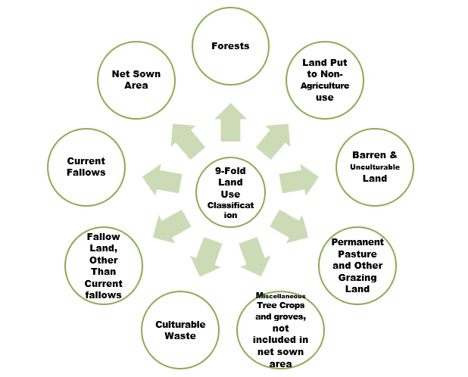

Slide 10
India’s land use pattern
46% of the total geographic area being net sown,
22% forest cover,
8.5% barren and un-culturable waste land,
5.5% non-agricultural uses, and
the remaining area being used for tree crops, grooves, permanent pastures, and grazing lands.

Slide 11
Forest Resources
Forests are vast areas dominated by trees and other vegetation, playing a critical role in maintaining the ecological balance and supporting a diverse range of species.
They cover approximately 31% of the Earth's land area and are integral to the health of our planet.

Slide 12
Forests provide numerous ecosystem services, including:
1. Carbon Sequestration: Forests act as significant carbon sinks, absorbing carbon dioxide from the atmosphere during photosynthesis and storing it in biomass and soil. This process helps mitigate climate change by reducing greenhouse gases.
2. Water Regulation: Forests regulate water cycles by preventing soil erosion, protecting watersheds, and ensuring a steady supply of clean water. Trees release water vapor through transpiration, contributing to cloud formation and rainfall.

Slide 13
3. Biodiversity: Forests are home to a vast array of flora and fauna, many of which are unique and endangered. They serve as genetic reservoirs, providing resources for medicine and agriculture.
4. Climate Regulation: By moderating temperatures and weather patterns, forests play a crucial role in maintaining the Earth's climate balance.

Slide 14
5. Provision of Resources: Forests provide essential resources such as timber, fuel wood, medicinal plants, and food. Many communities depend on these resources for their livelihoods.

Slide 15
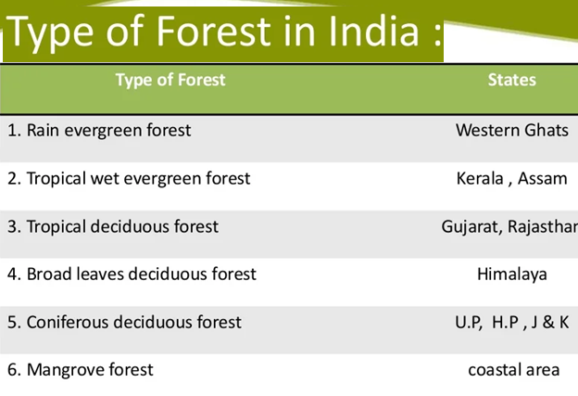
forest and energy resources- their associated problems and remedial measures

Slide 16
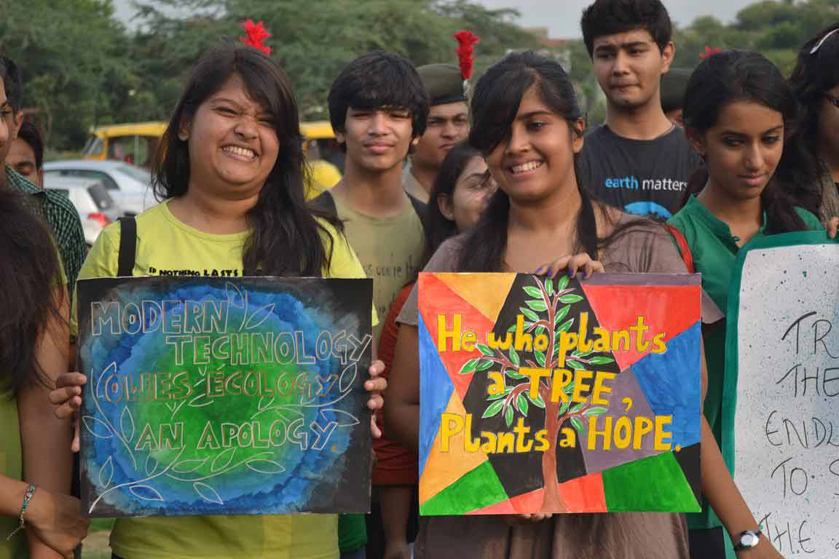

Slide 17
Their associated problems
Inadequate and Dwindling Forest Cover:
Low Productivity:
Nature of Forests and their Uneconomical Utilization:
Forest Fires:
Plant Diseases, Insects and Pests:
obsolete Methods of Lumbering and Sawing
Lack of Commercial Forests
Lack of Scientific Techniques:
Undue Concessions to Tribals and Local People:
Rapid Industrialization and urbanization

Slide 18
At present there is an urgent need of undertaking silvicultural operations on a large scale. This can be done through the following measures:
Intensive development schemes for afforestation should be adopted.
High yielding varieties should be planted in suitable areas.
3. Improved techniques of logging and extraction should be used.
4. Proper transport facilities should be provided to remote and inaccessible forest areas.
5. Saw mills should get uninterrupted power supply.

Slide 19
5. Latest techniques of seasoning and preservation are necessary to avoid wastage.
6. Proper arrangements to save forests from fires and plant diseases can go a long way to solve several problems.
7. A thorough inventory of forest resources is necessary to make an accurate assessment of our forest resources and make plans for their proper use.
8. Shifting cultivation should be discouraged and tribals depending on this type of cultivation should be provided with alternate sources of livelihood.
9. People associated with forest protection should be properly trained.

Slide 20
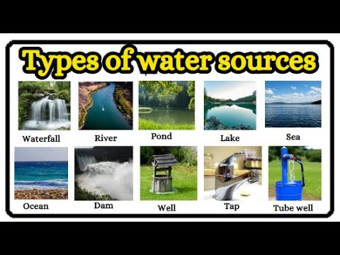

Slide 21
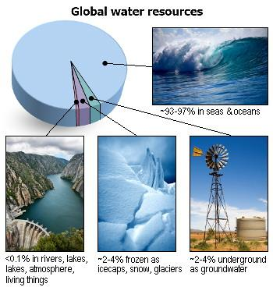

Slide 22
Problems associated with water resource

Slide 23
1. Indiscriminate and unsustainable water usage

Slide 24
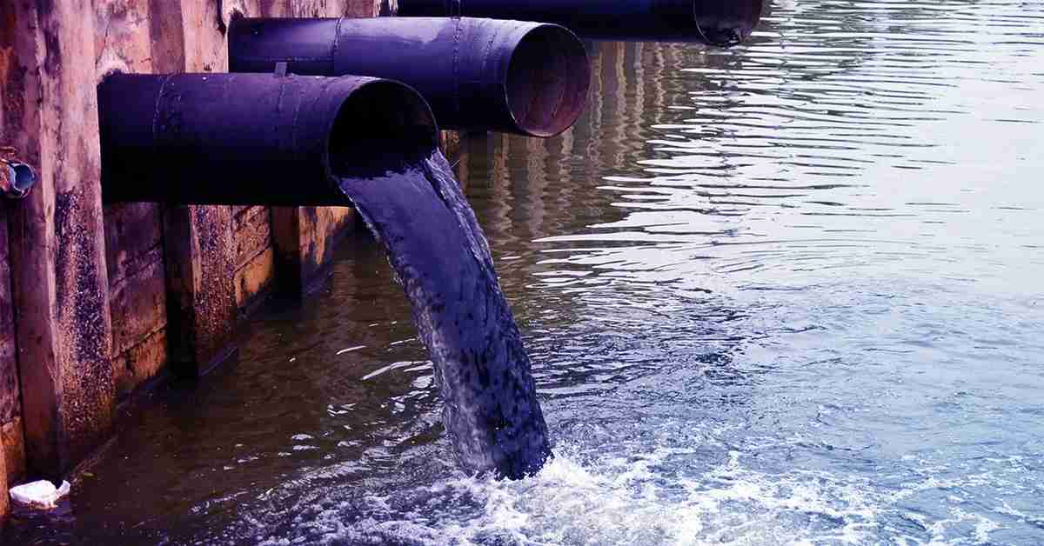
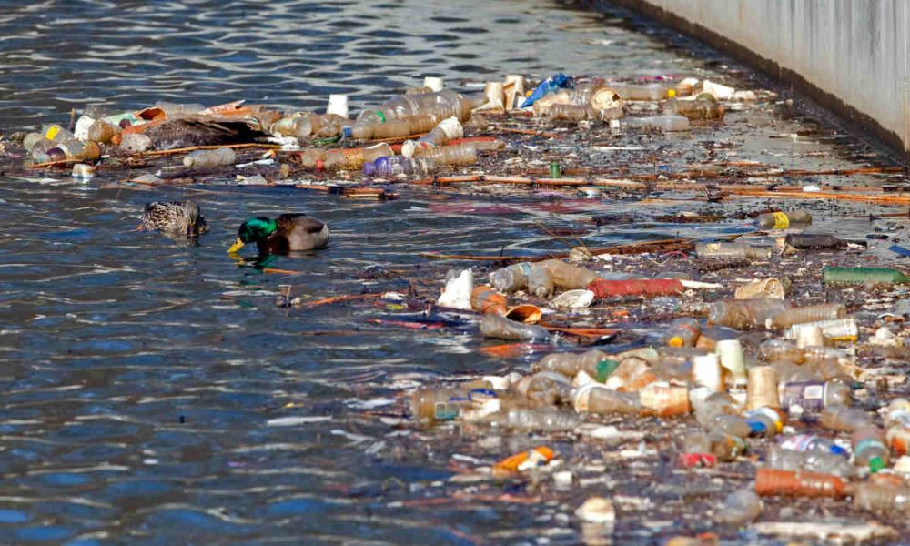
2. Pollution and Contamination
Industrial waste discharge into rivers and lakes
Agricultural runoff containing pesticides and fertilizers
Sewage and domestic waste contamination
Chemical pollutants making water unsafe for drinking

Slide 25
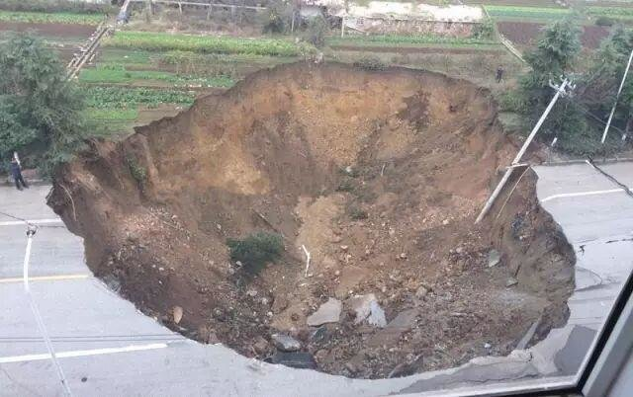
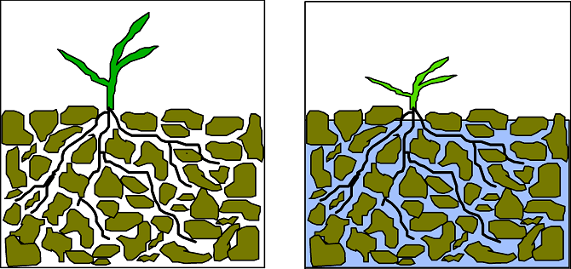
3. Over exploitation of ground water
Ground subsidence
Lowering water table
Reduced surface water flow
Increased power consumption
Water logging
Ground water pollution

Slide 26
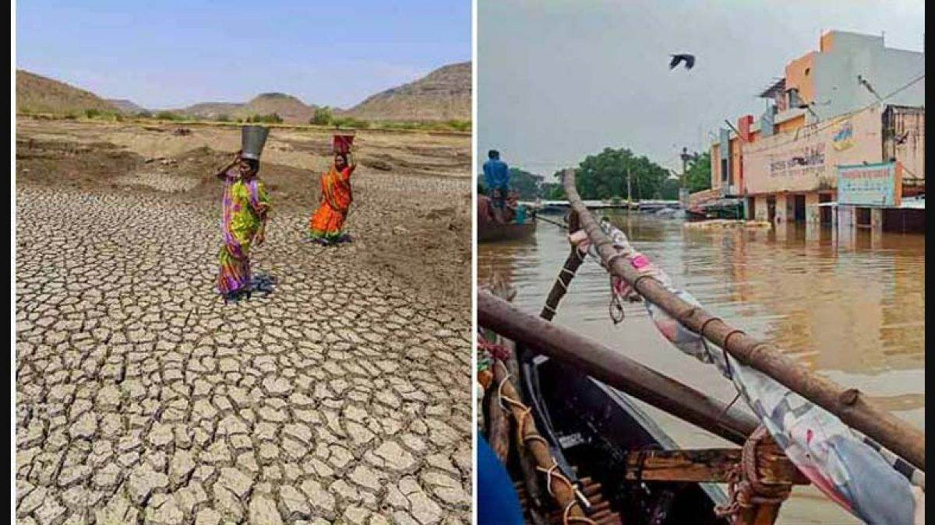
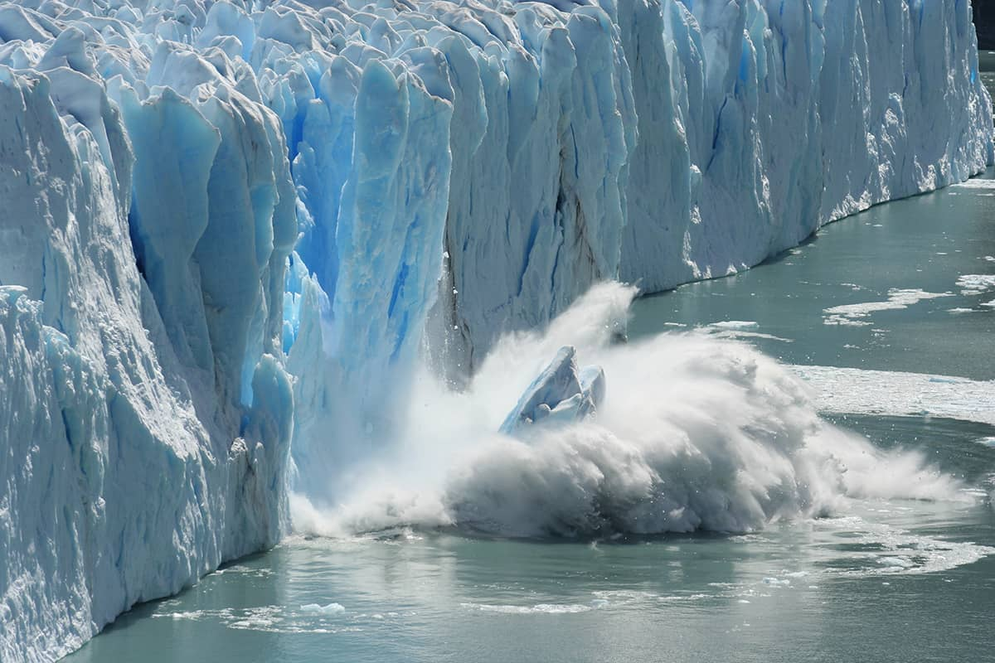
4. Climate Change Impact
Irregular rainfall patterns affecting water availability
Increased frequency of floods and droughts
Melting glaciers affecting river water supply
Rising sea levels causing saltwater intrusion

Slide 27
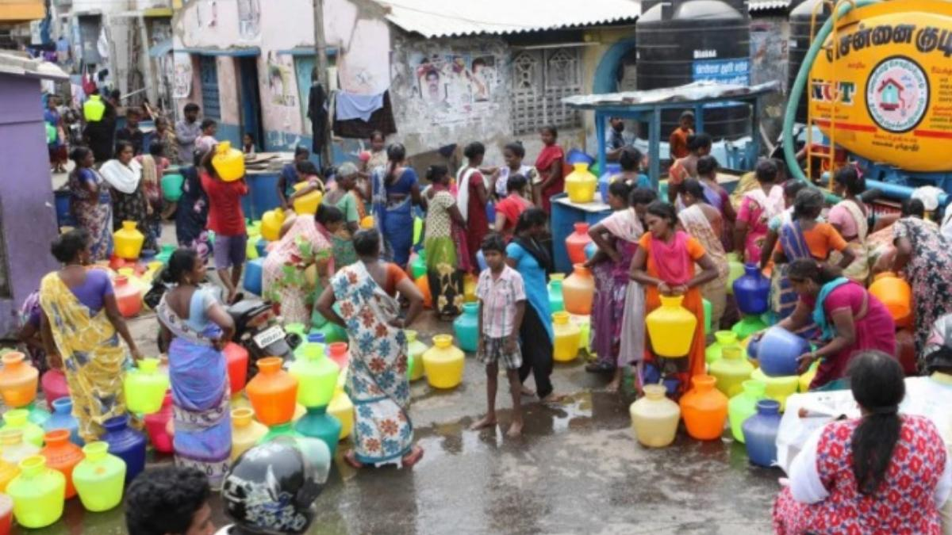
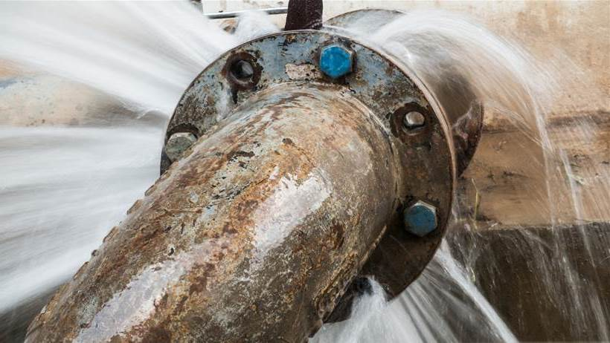
5. Infrastructure Issues
Inadequate water supply systems in rural and urban areas
Poor water storage and distribution facilities
Leakage and wastage in water distribution networks
Lack of proper sewage treatment plants

Slide 28
Individuals play a crucial role in conserving natural resources through sustainable practices
Water Conservation
Fix Leaks: Promptly repair leaks in taps and toilets to prevent water wastage.
Efficient Usage: Avoid leaving taps running while brushing teeth or washing dishes.
Rainwater Harvesting: Install systems to collect rainwater for gardening and other non-potable uses.
Irrigation Practices: Use drip irrigation and other efficient watering methods to minimize evaporation losses.

Slide 29
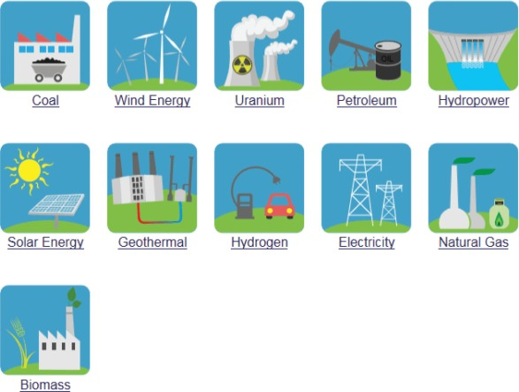
ENERGY RESOURCES

Slide 30
2. Energy Conservation
Turn Off Appliances: Switch off lights, fans, and electronic devices when not in use to save energy.
Use Natural Resources: Take advantage of natural light and heat; for example, dry clothes in the sun and use solar cookers when possible.
Energy-Efficient Appliances: Invest in energy-efficient appliances to reduce overall energy consumption

Slide 31
Education and Advocacy
Raise Awareness: Educate others about the importance of conservation and sustainable practices. Share knowledge within your community to inspire collective action.
Support Conservation Policies: Advocate for policies that promote conservation and sustainable resource management at local and national levels.
By adopting these practices, individuals can significantly contribute to the conservation of natural resources, ensuring their availability for future generations and promoting a healthier environment. Every small action counts, and collective efforts can lead to substantial positive changes in resource management and environmental sustainability.

Slide 32
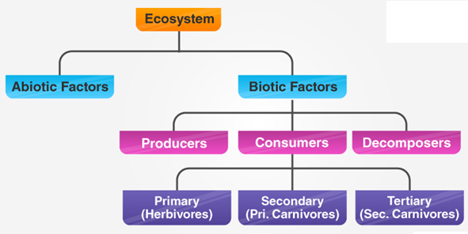

Slide 33
Functions of Ecosystem
The functions of the ecosystem are as follows:
It regulates the essential ecological processes, supports life systems and renders stability.
It is also responsible for the cycling of nutrients between biotic and abiotic components.
It maintains a balance among the various trophic levels in the ecosystem.
It cycles the minerals through the biosphere.
The abiotic components help in the synthesis of organic components that involve the exchange of energy.

Slide 34
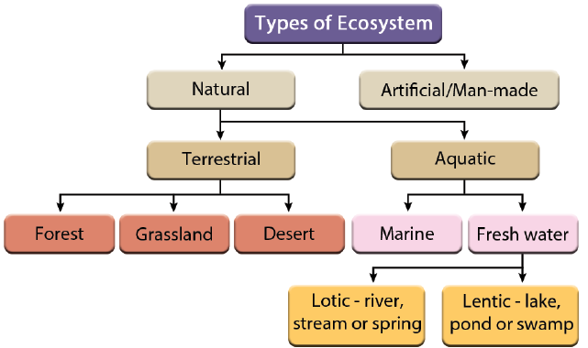

Slide 35
A food chain explains which organism eats another organism in the environment. The food chain is a linear sequence of organisms where nutrients and energy is transferred from one organism to the other.
This occurs when one organism consumes another organism.
It begins with the producer organism, follows the chain and ends with the decomposer organism.
In food chain, one organism is dependent upon another organism for survival.

Slide 36
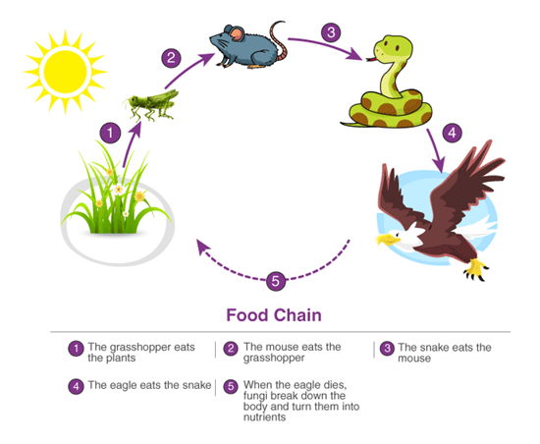

Slide 37
Types of Food Chain
Detritus food chain: includes different species of organisms and plants like algae, bacteria, fungi, protozoa, mites, insects, worms and so on.
The detritus food chain begins with dead organic material.
The food energy passes into decomposers and detritivores, which are further eaten by smaller organisms like carnivores.
Carnivores, like maggots, become a meal for bigger carnivores like frogs, snakes and so on.
Primary consumers like fungi, bacteria, protozoans, and so on are detritivores which feed on detritus.
Grazing food chain: starts with green plants, passes through herbivores and then to carnivores.
In a grazing food chain, energy in the lowest trophic level is acquired from photosynthesis.

Slide 38
Several interconnected food chains form a food web.
A food web is similar to a food chain but the food web is comparatively larger than a food chain.
Occasionally, a single organism is consumed by many predators or it consumes several other organisms.
Due to this, many trophic levels get interconnected.
The food chain fails to showcase the flow of energy in the right way.
But the food web is able to show the proper representation of energy flow, as it displays the interactions between different organisms.

Slide 39
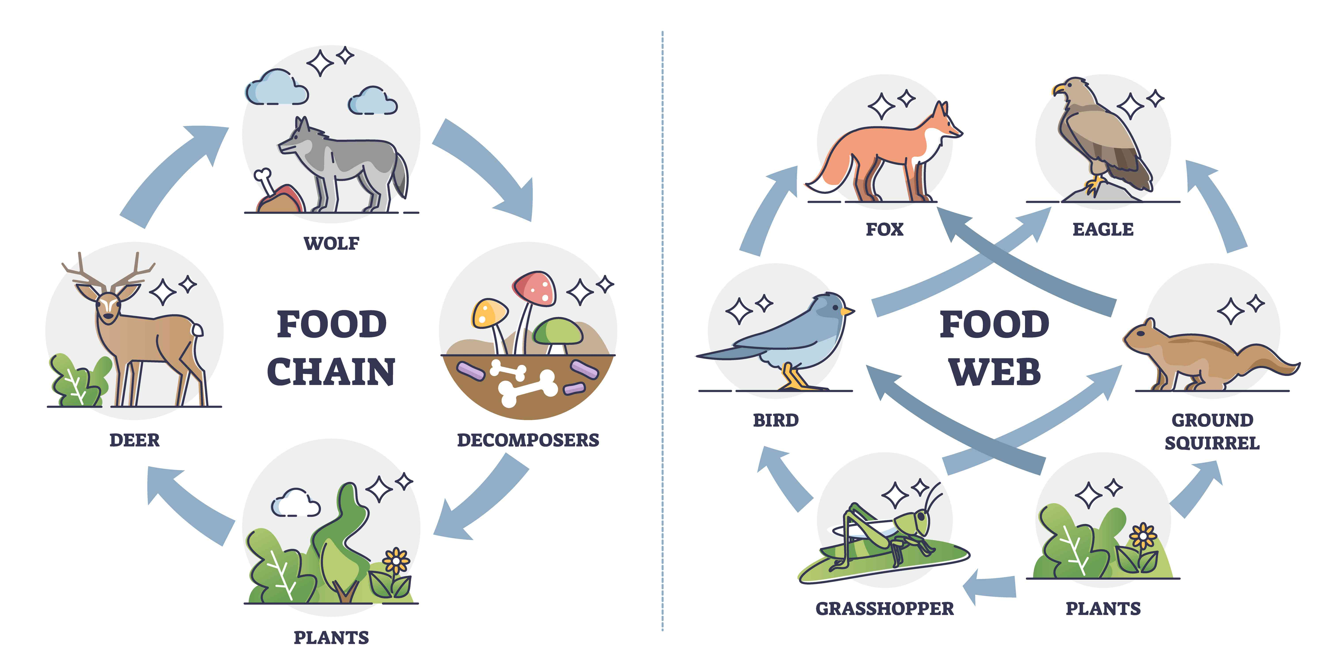

Slide 40
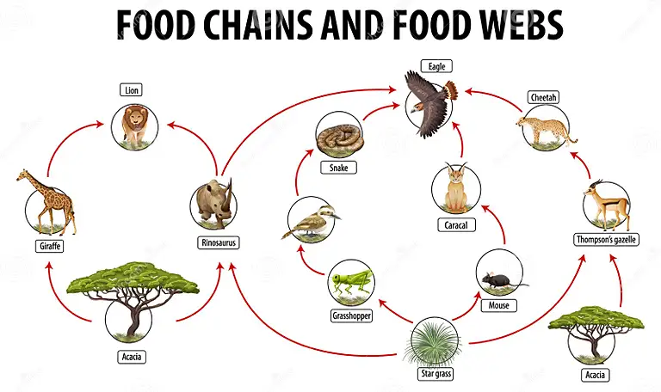

Slide 41
Ecological Pyramid
An ecological pyramid is a graphical representation of the relationship between the different living organisms at different trophic levels.
It can be observed that these pyramids are in the shape of actual pyramids, with the base being the broadest, which is covered by the lowest trophic level, i.e., producers.
The next level is occupied by the next trophic level, i.e., the primary consumers and so on.

Slide 42
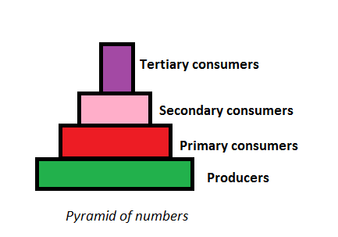
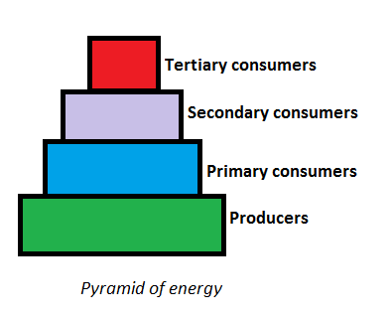
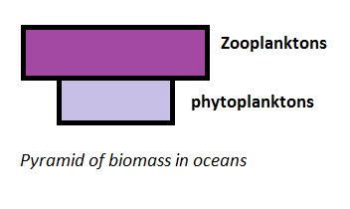
Types of Ecological Pyramid
Three types of ecological pyramids exist. They are as follows:
Pyramid of Numbers
Pyramid of Biomass
Pyramid of Energy

Slide 43
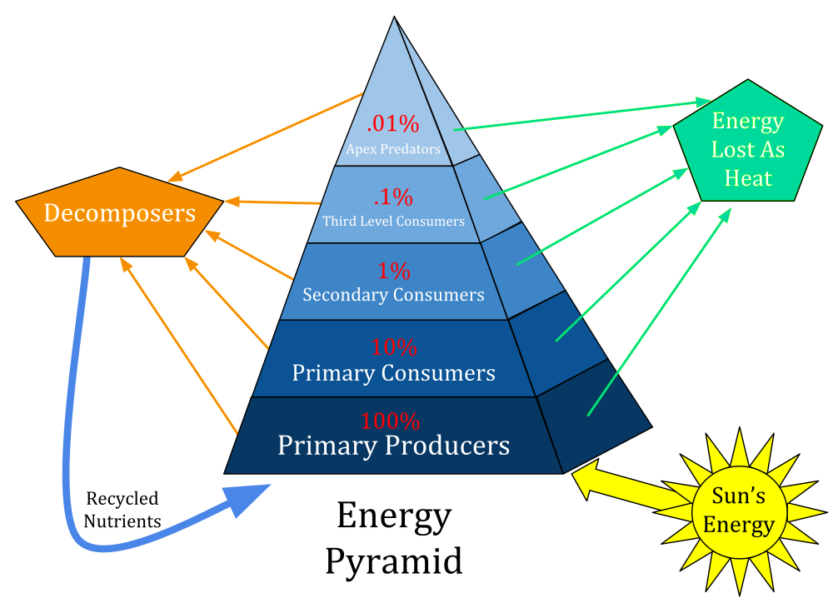

Slide 44
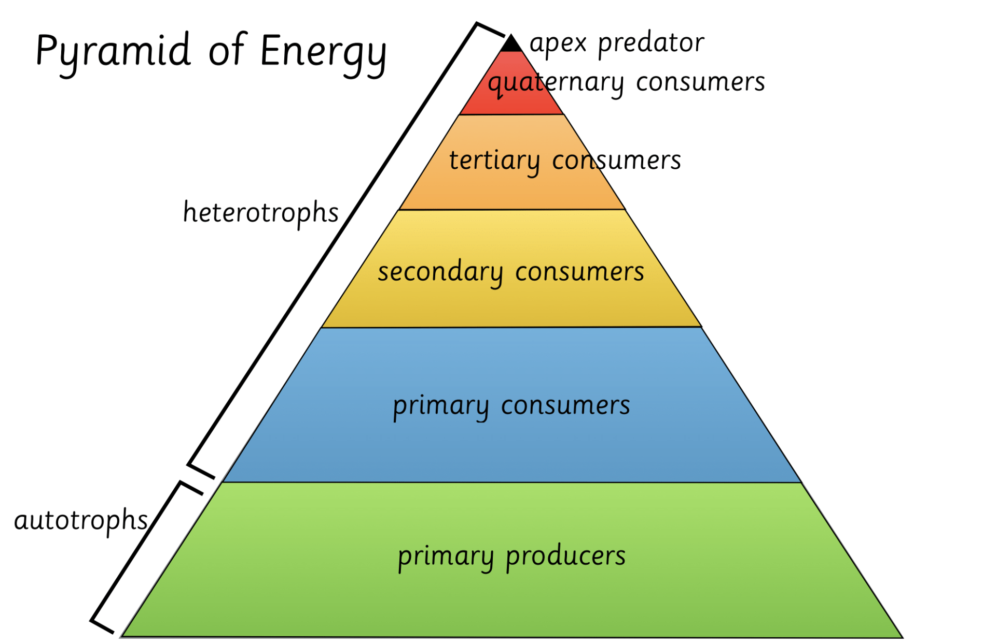

Slide 45
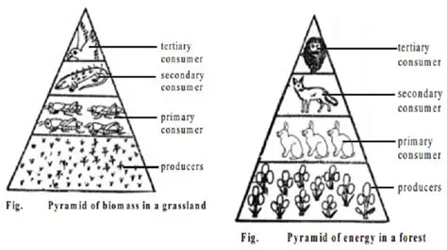

Slide 46
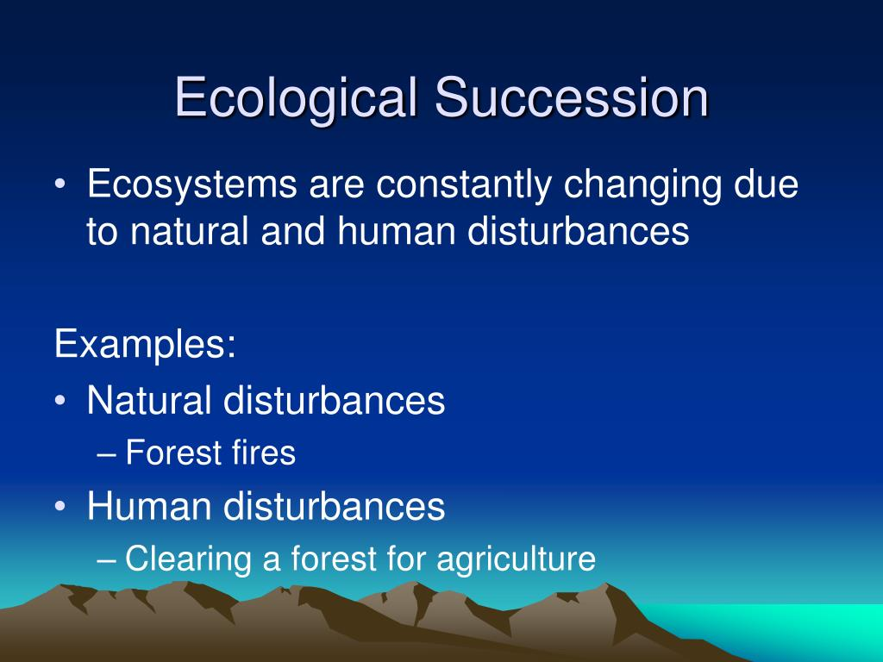

Slide 47
